Slide 1
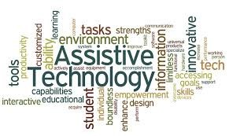
Library Equal Access Program (LEAP), at Seattle Public Library
CJ Glenn, Supervising Librarian and Seth Taylor, Library Associate IV
S
Notes:
What LEAP Does: The Library Equal Access Program (LEAP) increases library accessibility for patrons with disabilities.
Proactive accessibility for library programs and services
Advice and support
Event accessibility- captioning, assistive listening systems
Assistive technology throughout system
Software
Hardware
Accessibility Toolkits (what should be in them, how to refresh)
Accommodations (forms and info on spl.org- search for ADA)
ADA Borrower
ASL interpreters
Other types of accommodations
Best practices for when patrons are requesting immediate accommodations in branches
LEAP Lab
1:1 Appointments

Slide 2
Assistive technology available throughout the Seattle Public Library system:
ZoomText, a screen magnification software and JAWS, a screen-reading software, are available on all library computers throughout the system
Accessibility Kits which include a variety of magnifiers and writing guides as well as a large-type, high-contrast PC keyboard, are available at all branch locations
CCTV Magnifiers: Two at the Central Library (one in LEAP lab and one on Level 5) and one each at the Lake City and Rainier Beach branches

Slide 3
Refreshable braille displays: Two Focus 80s at the Central Library (one in LEAP and one on Level 5), and four Focus 40s, one each at Broadview, Colombia, Southwest and University branches
Braille Embosser: One in the LEAP Lab at the Central Library
Scan EZs: Scanners with the ability to scan documents to an audio file in multiple languages. Two at the Central Library and one each at the Broadview, Lake City, Northeast, Ballard, Capitol Hill, Douglass Truth, Beacon Hill, Colombia, New Holly, Rainier Beach, Delridge, High Point and South Park branches
One Sorenson Video Phone on Level 1 of the Central Library

Slide 4

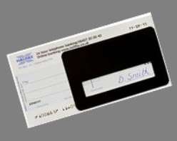
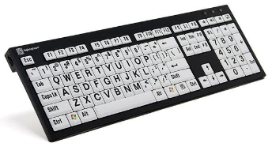
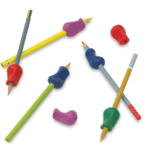
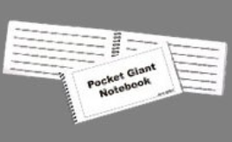
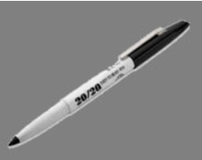
Accessibility Kits
Low Vision Signature Guide
Large Type/High Contrast Keyboard
Low Vision Note Writing Frame
Low Vision Writing Tablet
Thick Pen (20/20 Marker)
Pen or Pencil Grip

Slide 5
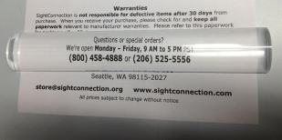
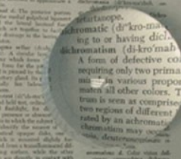
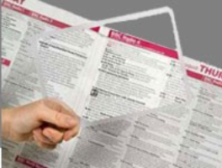
Accessibility Kits: Magnifiers
Bar Magnifier
Dome Magnifier
Sheet Magnifier

Slide 6
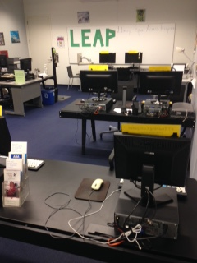
In the LEAP Assistive Technology Lab at the Central Library:

Slide 7
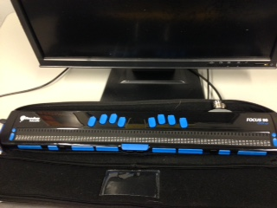
Two Focus 80 refreshable braille systems for reading and inputting computer-generated text in braille

Slide 8
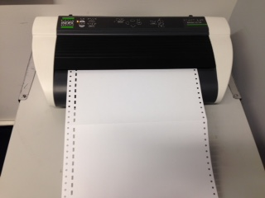
Duxbury text-to-braille translation software, used with an Index D Braille Embosser which allows patrons to emboss braille documents

Slide 9
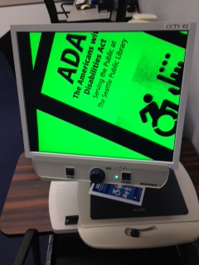
Two Closed Circuit Television Systems (CCTV) allow people to magnify printed materials, handwritten materials and images

Slide 10
JAWS (Job Access With Speech) Overview
Screen reader for Windows
Translates text to speech that can be accessed by users with headphones or speakers and also translates to braille that can be accessed by way of a refreshable braille display
Accessible through throughWindows keyboard commands and JAWS hotkeys
The #NoMouse Challenge: https://nomouse.org/
LEAP can provide basic instruction and support as well as resources for more in-depth instruction

Slide 11
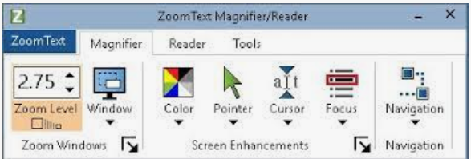
ZoomText Overview
Screen magnification software that enlarges and enhances everything on the screen
Many ways to customize view including, color contrast, pointer size and color, cursor size and color, focus, and areas of the screen can be designated to remain unmagnified.
LEAP is able to provide introductory instruction and ongoing patron support in their use of ZoomText magnifier

Slide 12
Duxbury Overview
Translates documents into Braille to be embossed on Index V Braille Embosser
Patrons must receive training from LEAP staff before using the embosser without staff support
Patrons may arrange to have documents embossed by LEAP staff and picked up at the Central Library
Not a production embosser, so please limit documents to 10 or so embossed pages per use
LEAP can provide information about resources for larger embossing jobs

Slide 13
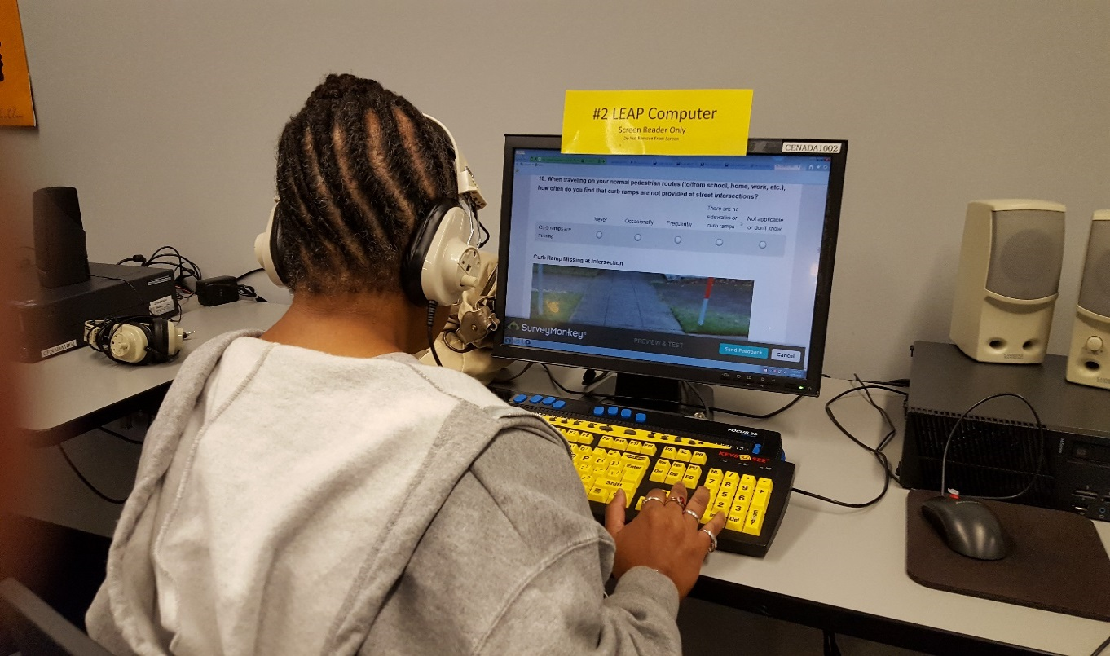
Drop-in Technology Lab Hours
Current Hours: Mondays from 2:00 PM-6:00 PM and Wednesdays and Fridays from 12:00 PM-6:00PM

Slide 14
LEAP Programs and Services
Use of LEAP Lab assistive technology during open hours
Support with and introductory training on use of assistive technology during open hours
Support and assistance with navigating all library programs and services
ADA accommodation request support including sign language interpretation requests
Coordination of live captioning and ASL interpretation for select virtual and in-person library programs
Low Vision Book Group

Slide 15
Questions?
CJ Glenn Supervising Librarian, Seattle Public Library
Library Equal Access Program (LEAP)
(206) 615-1380 leap@spl.org or c.j.glenn@spl.org
Seattle Public Library
1000 Fourth Avenue
Seattle, WA 98104
www.spl.org

